Slide 1
WALMART SALES ANALYSIS PROJECT Sales Performance Analysis of Walmart Stores Using Advanced MySQL Techniques
Introduction:
Walmart, a major retail chain, operates across several cities, offering a wide range of products. The dataset
provided contains detailed transaction data, including customer demographics, product lines, sales figures, and
payment methods. This project will use advanced SQL techniques to uncover actionable insights into sales
performance, customer behavior, and operational efficiencies.
Business Problem:
Walmart wants to optimize its sales strategies by analyzing historical transaction data across branches,
customer types, payment methods, and product lines. To achieve this, advanced MySQL queries will be
employed to answer challenging business questions related to sales performance, customer segmentation, and
product trends.

Slide 2
KEY COLUMNS OF WALMARTSALES DATASET
Invoice ID: Unique identifier for each transactions
. Branch: The store branch where the transaction took place
. City: City corresponding to the branch location
. Customer type: Categorizes customers as either Member or Normal
. Gender: Customer gender
. Product line : Specifies the type of product purchased
. Unit Price: Price per unit of the purchased item
. Quantity: Number of items purchased in transaction
. Tax 5%: The 5% tax calculated on total purchase
. Total: The final amount paid, including tax
. Date: The date of Transaction
Time: The time transaction Occurred
. Payment: Payment method used
. Cogs(Cost Of Good Sold): The direct cost of producing the goods sold
. Gross Income: The Calculated profit for the transaction
. Gross Margin Percentage: The profit margin percentage
. Rating: Customer satisfaction rating
. Customer id: Unique identifier for each customer

Slide 3
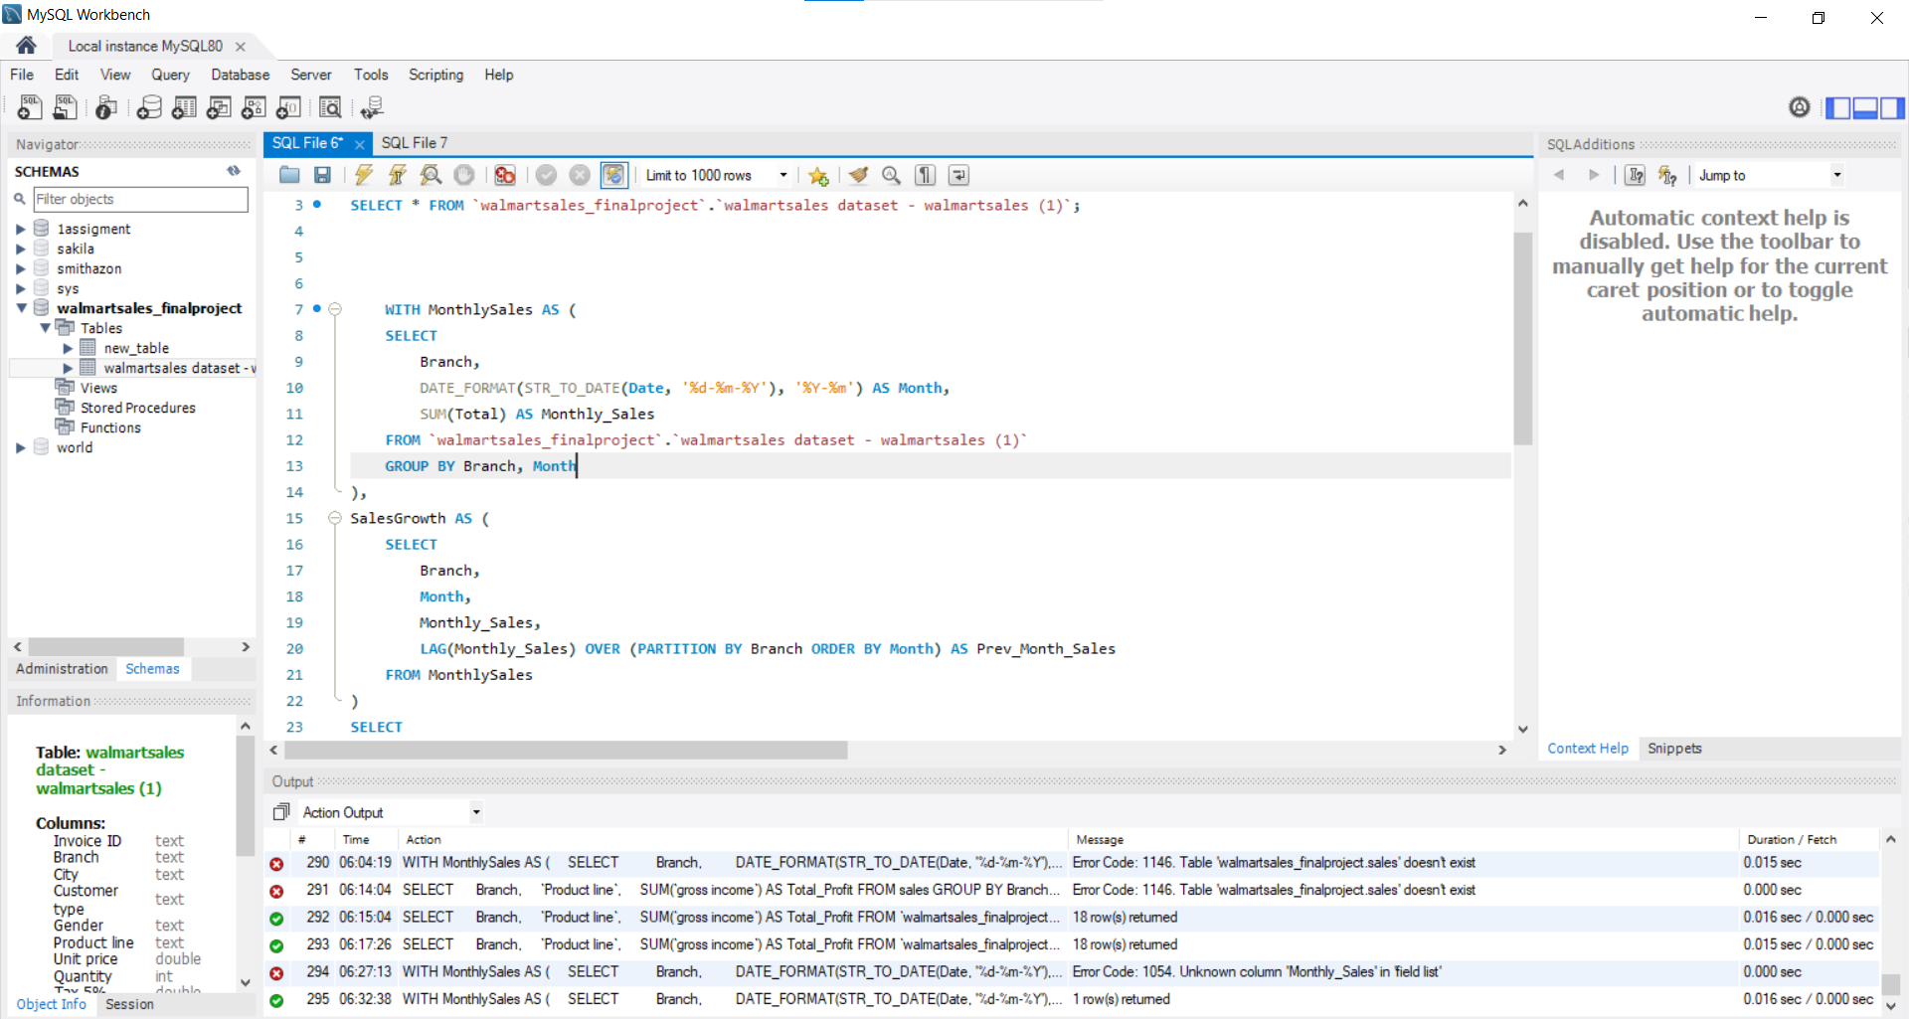

Slide 4
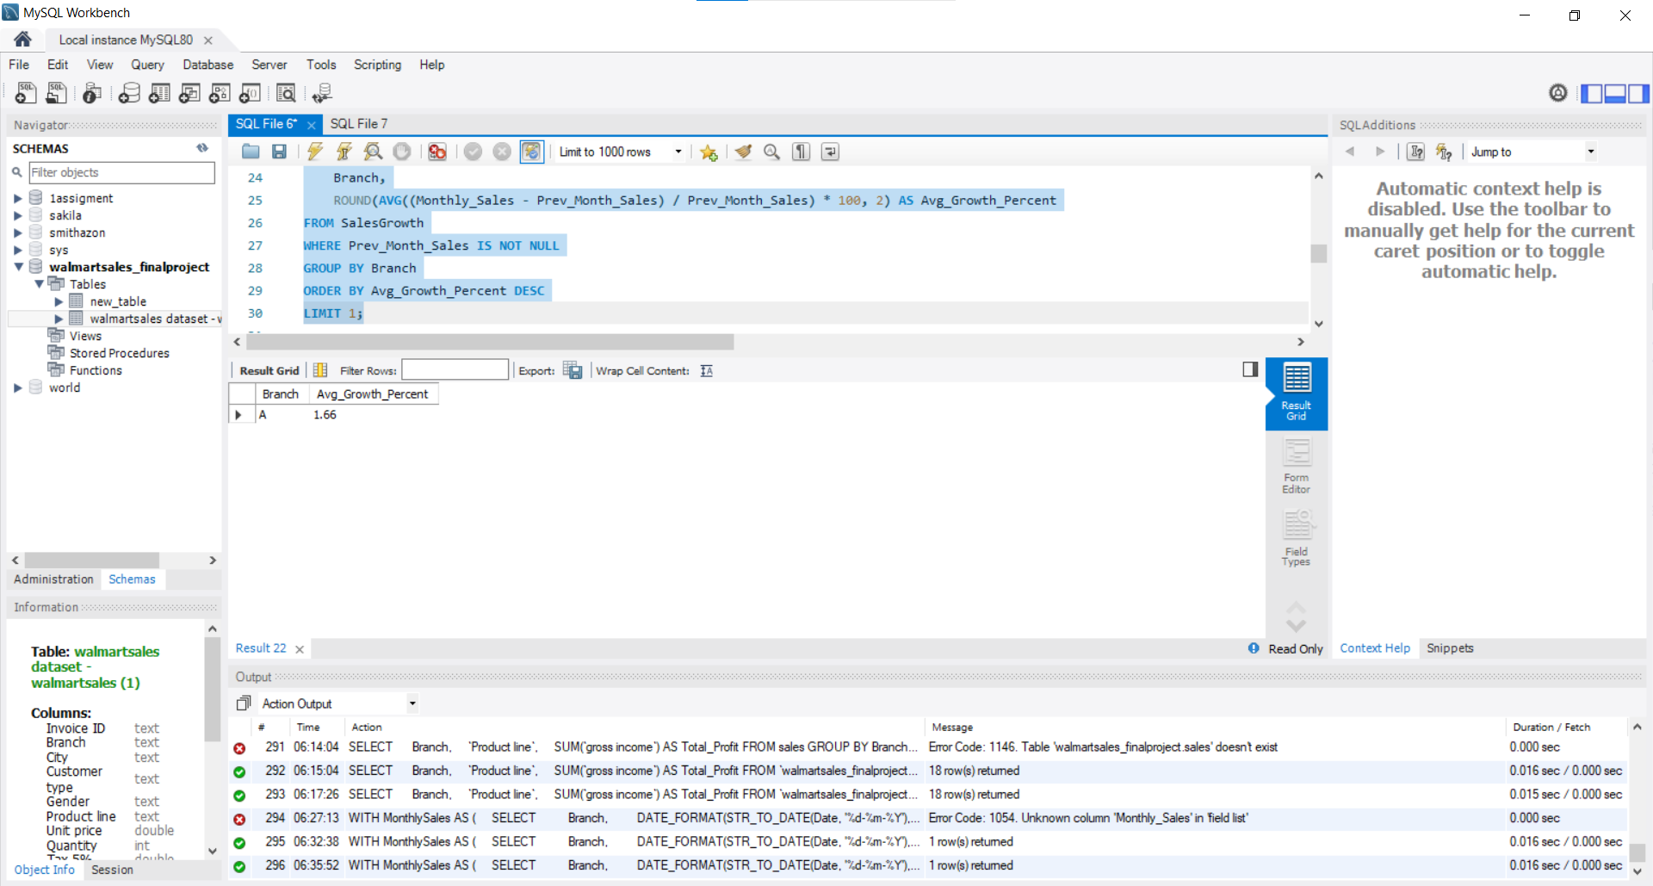

Slide 5
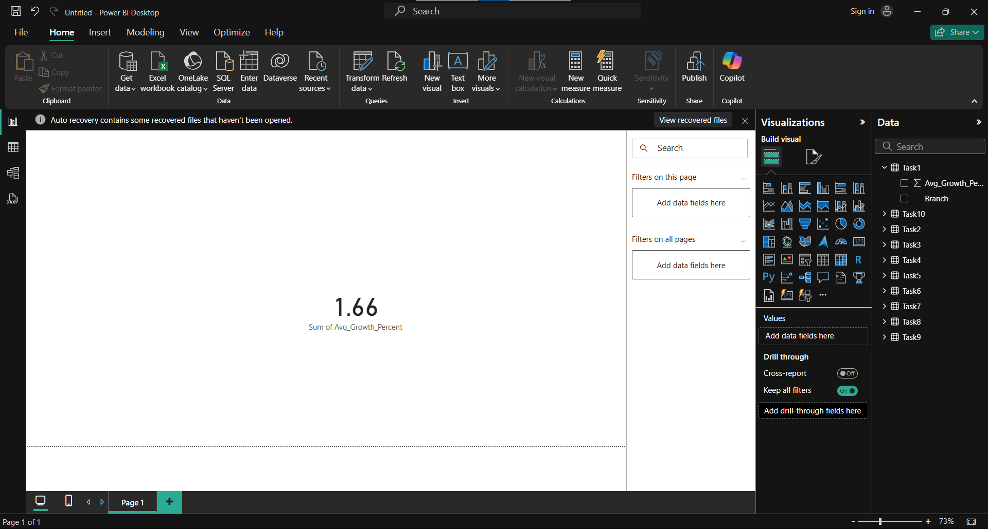

Slide 6
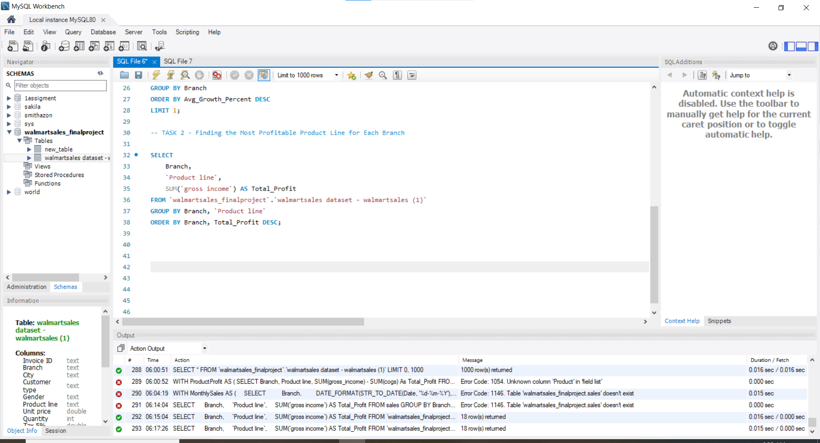

Slide 7
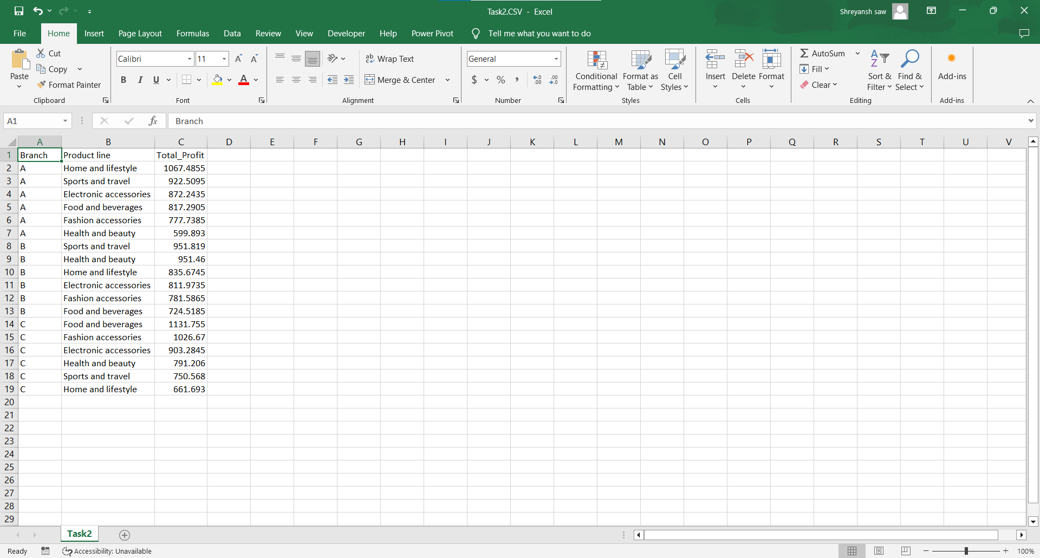

Slide 8
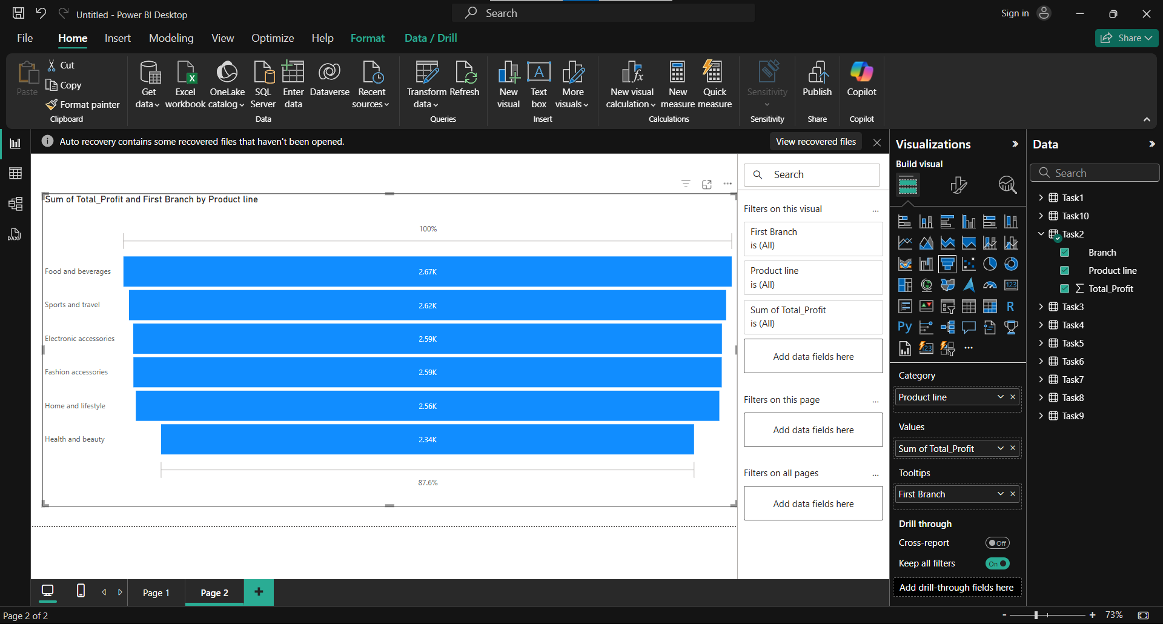

Slide 9
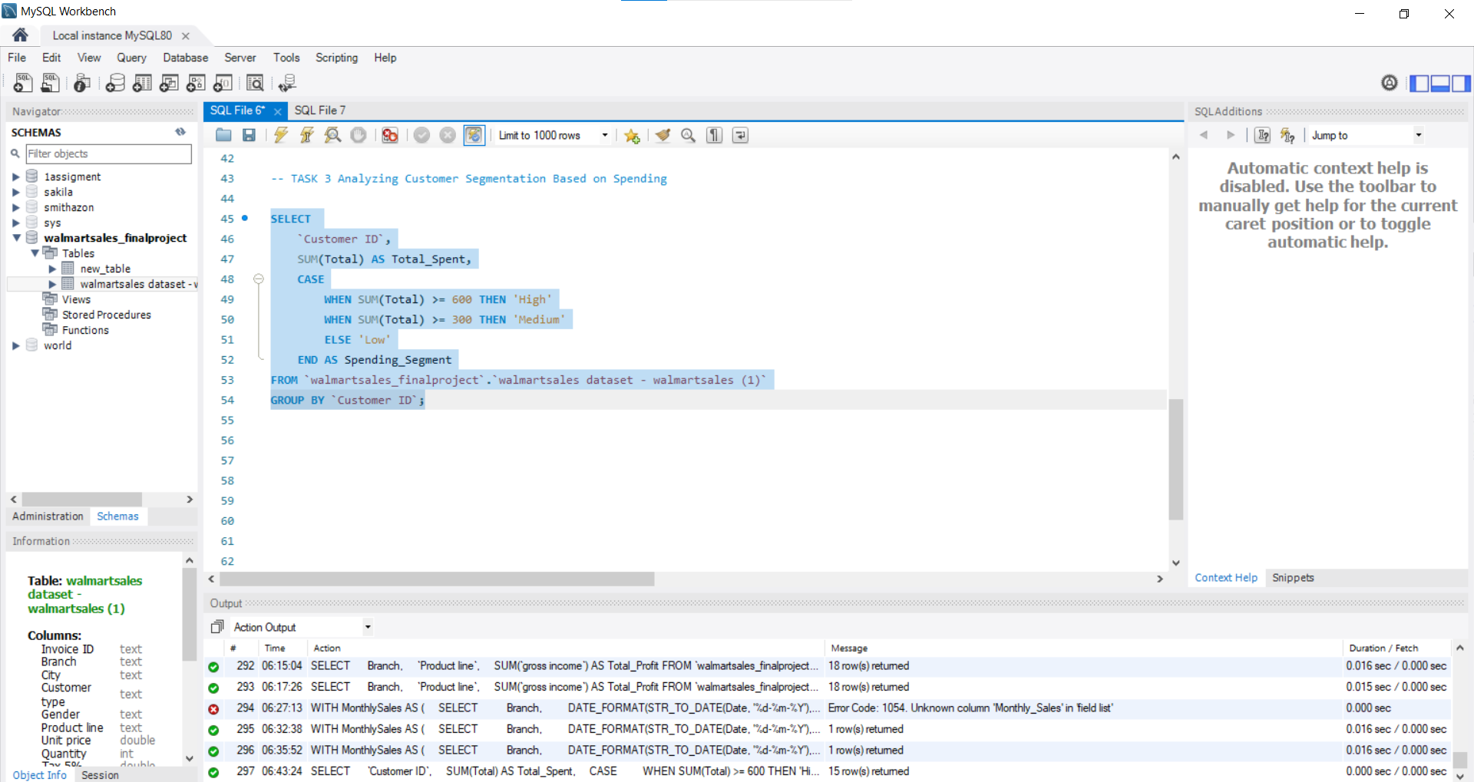

Slide 10
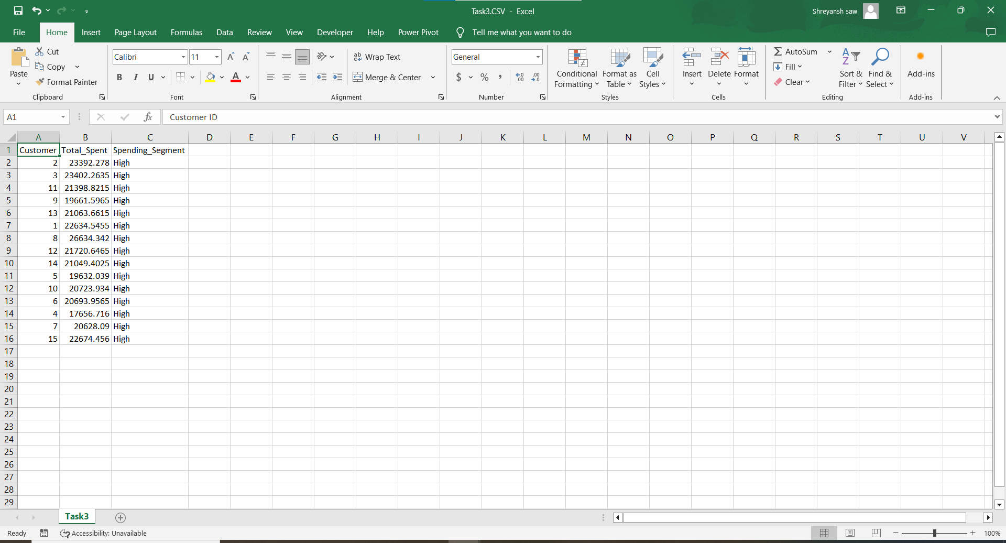

Slide 11
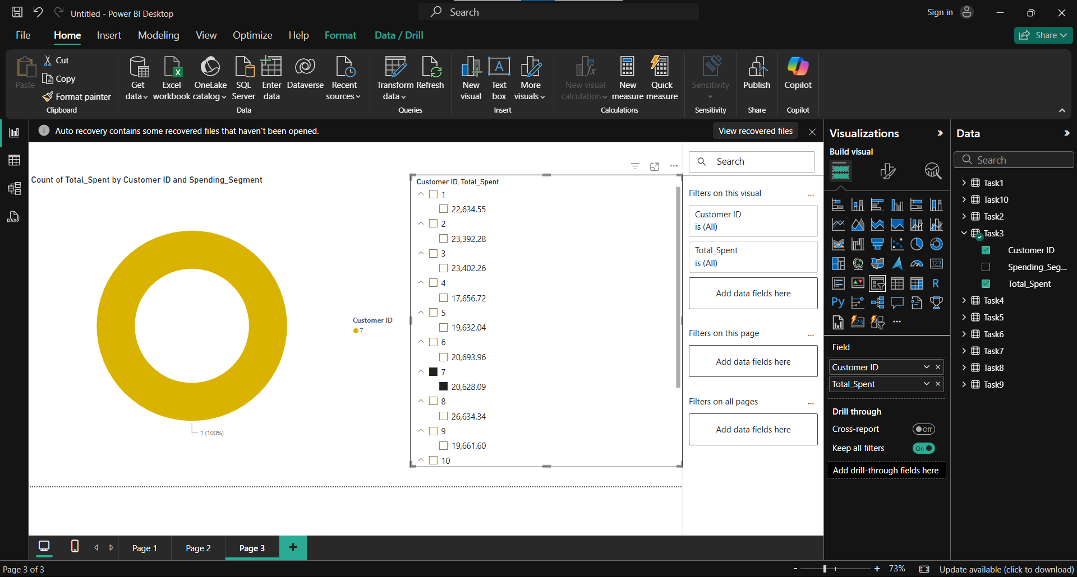

Slide 12
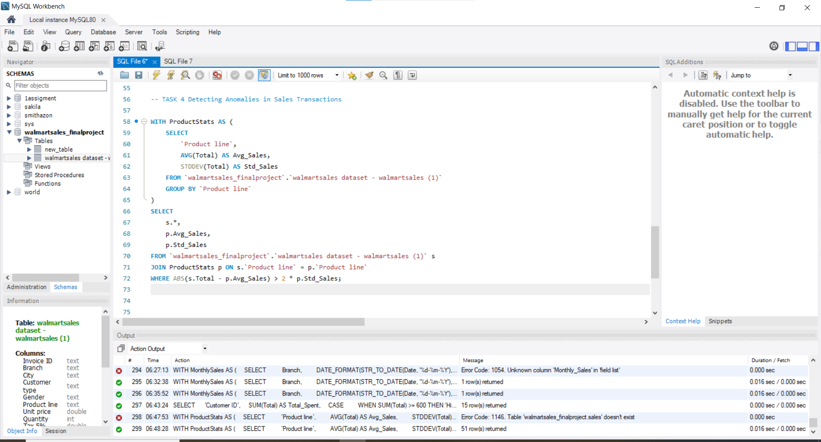

Slide 13
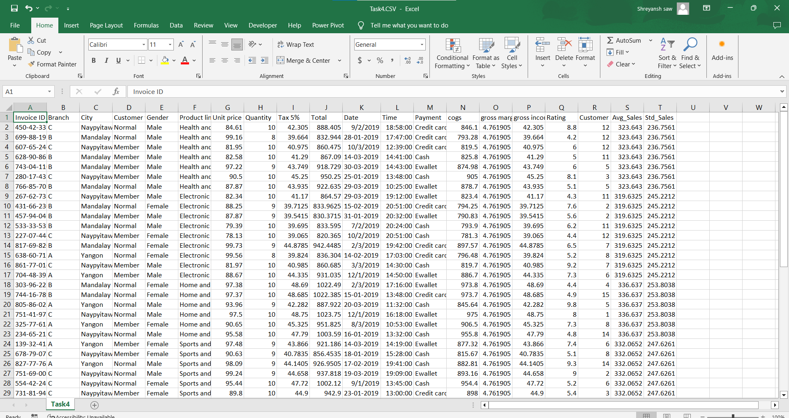

Slide 14
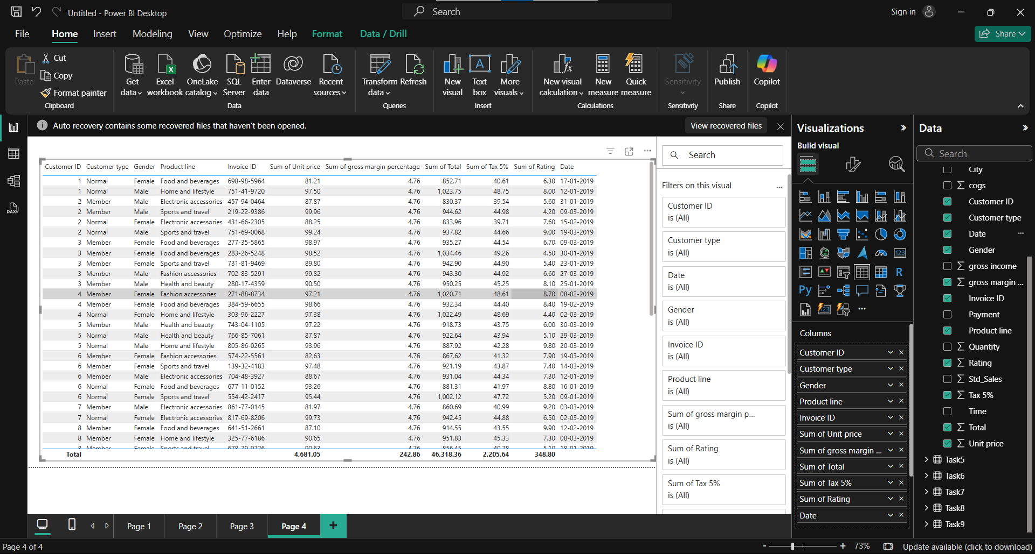

Slide 15
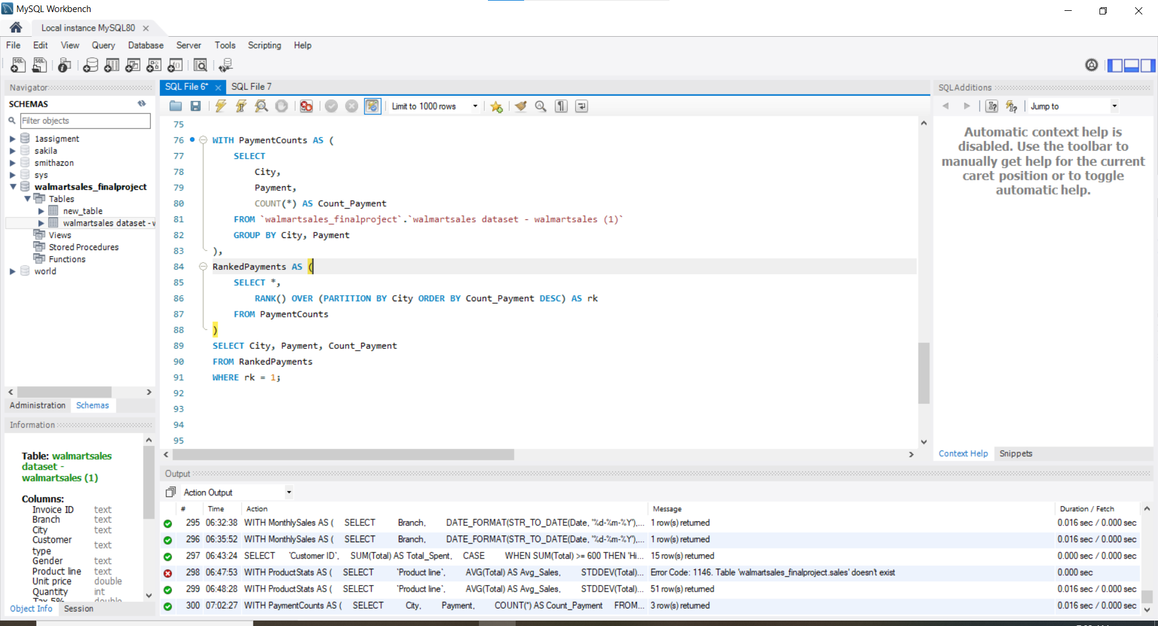

Slide 16
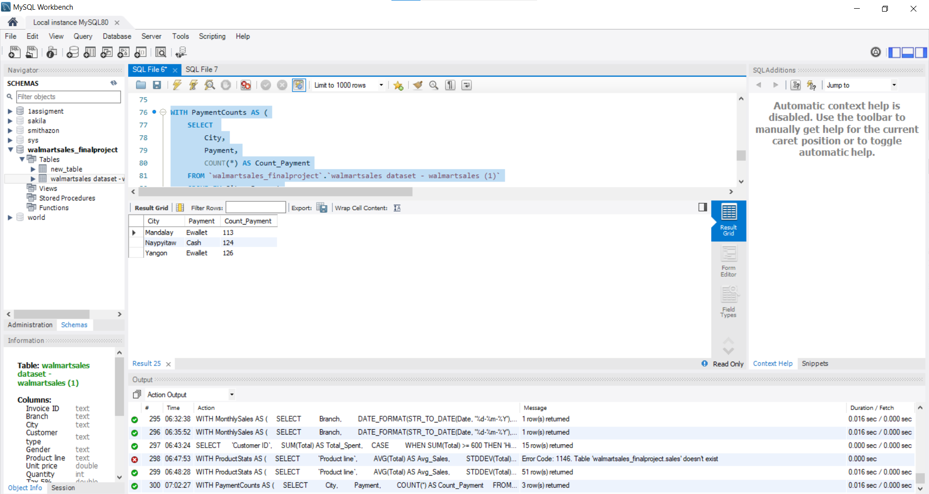

Slide 17
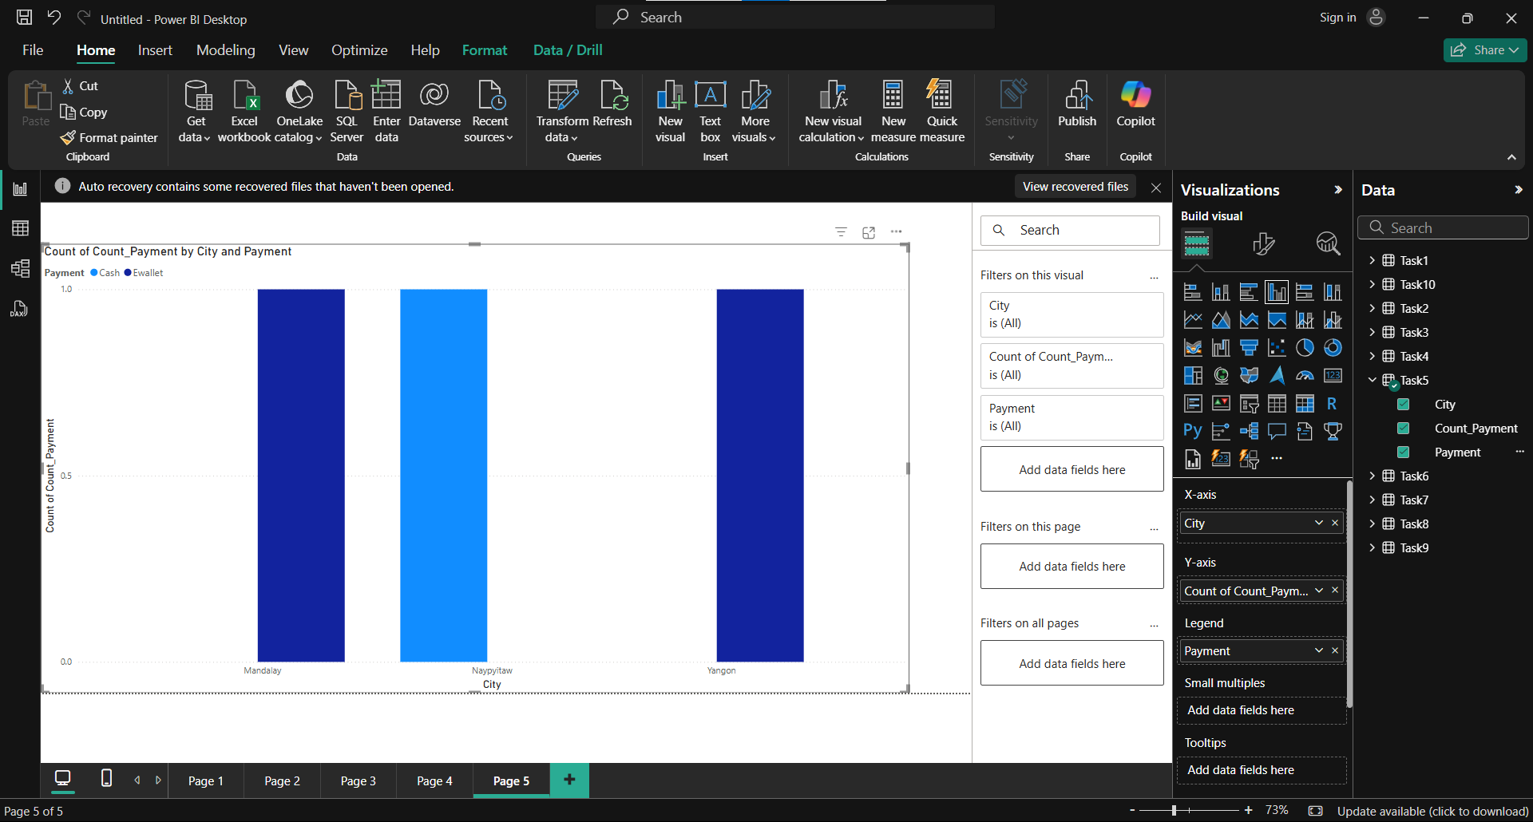

Slide 18
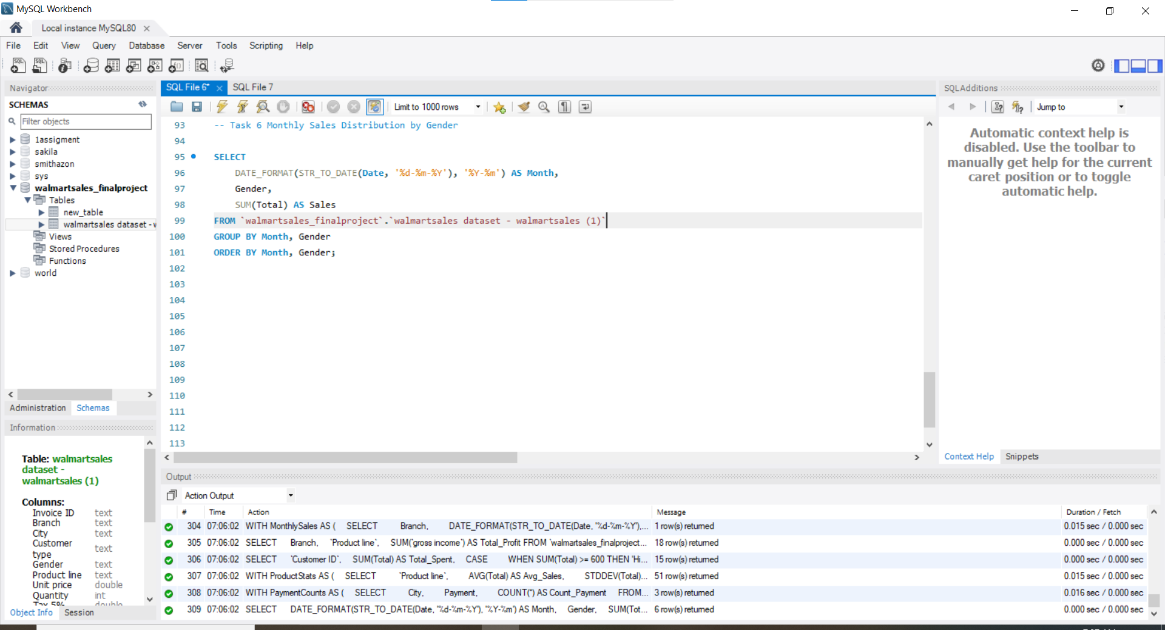

Slide 19
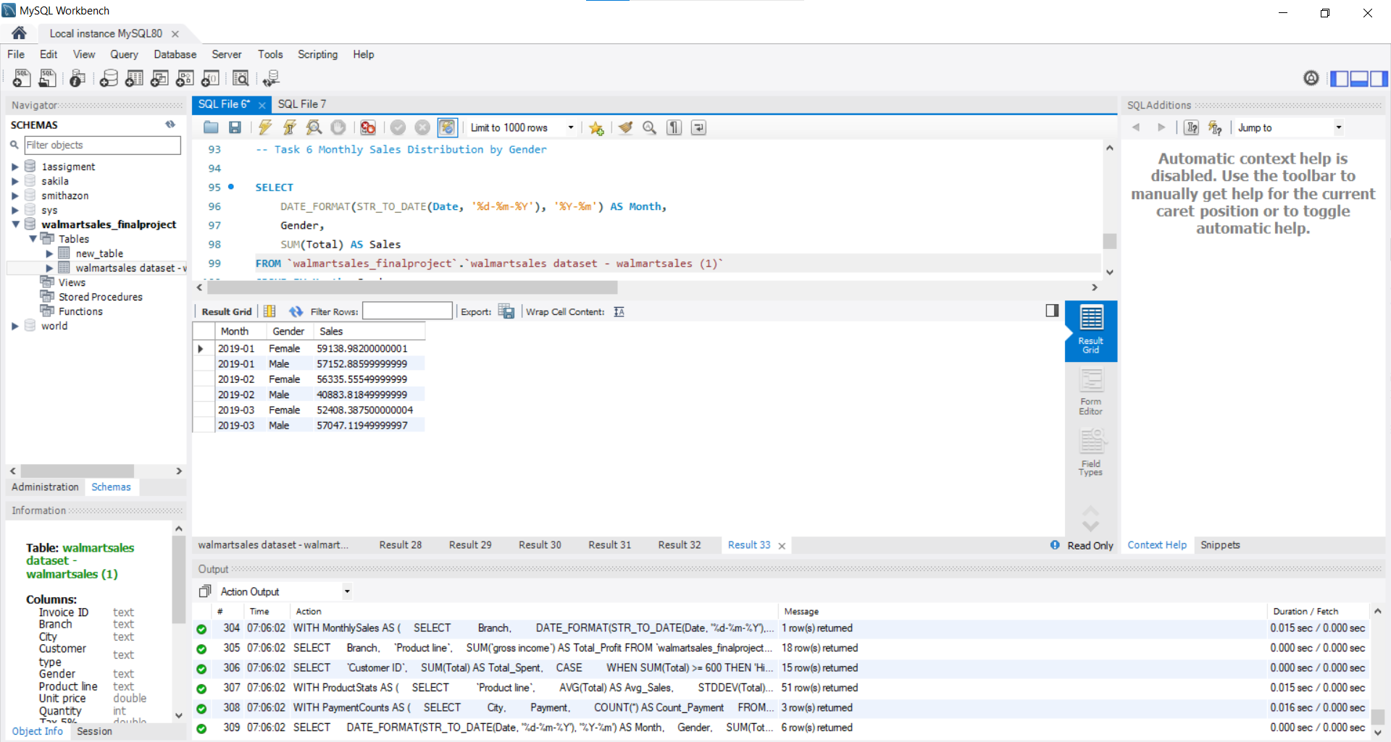

Slide 20
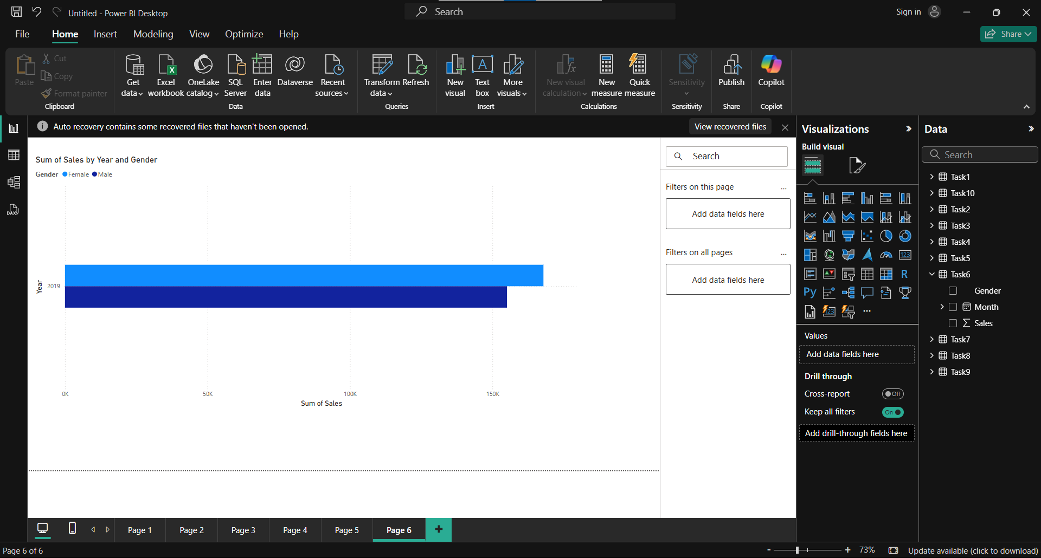

Slide 21
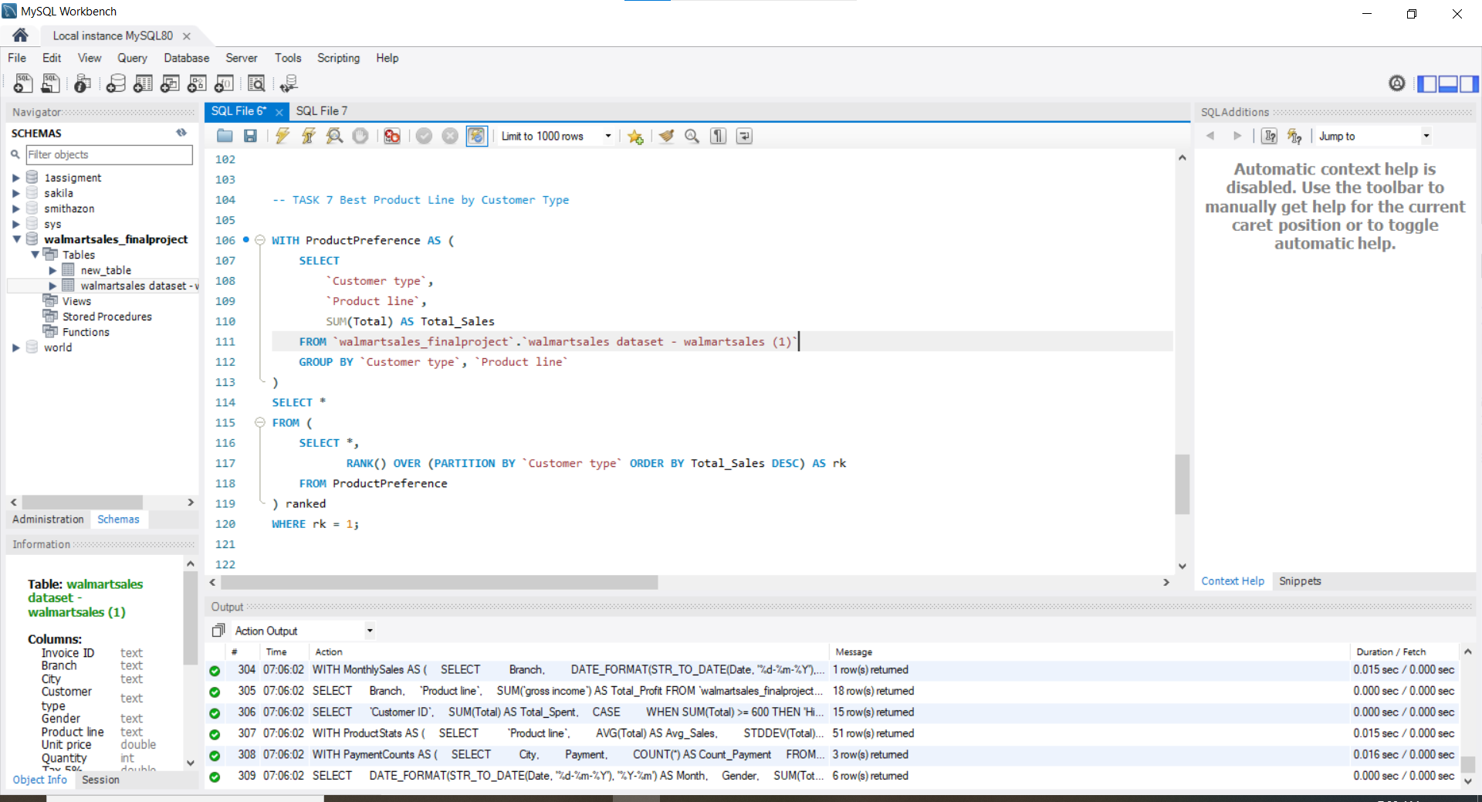

Slide 22
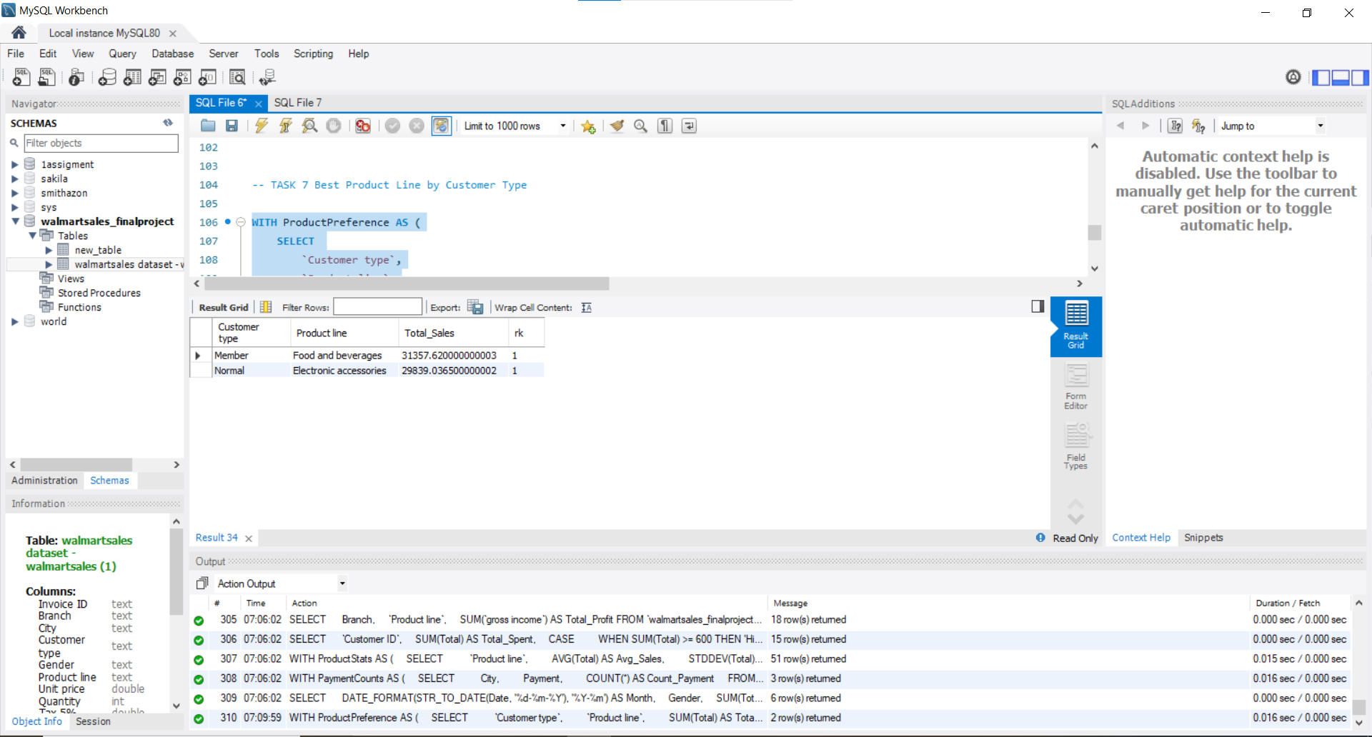

Slide 23
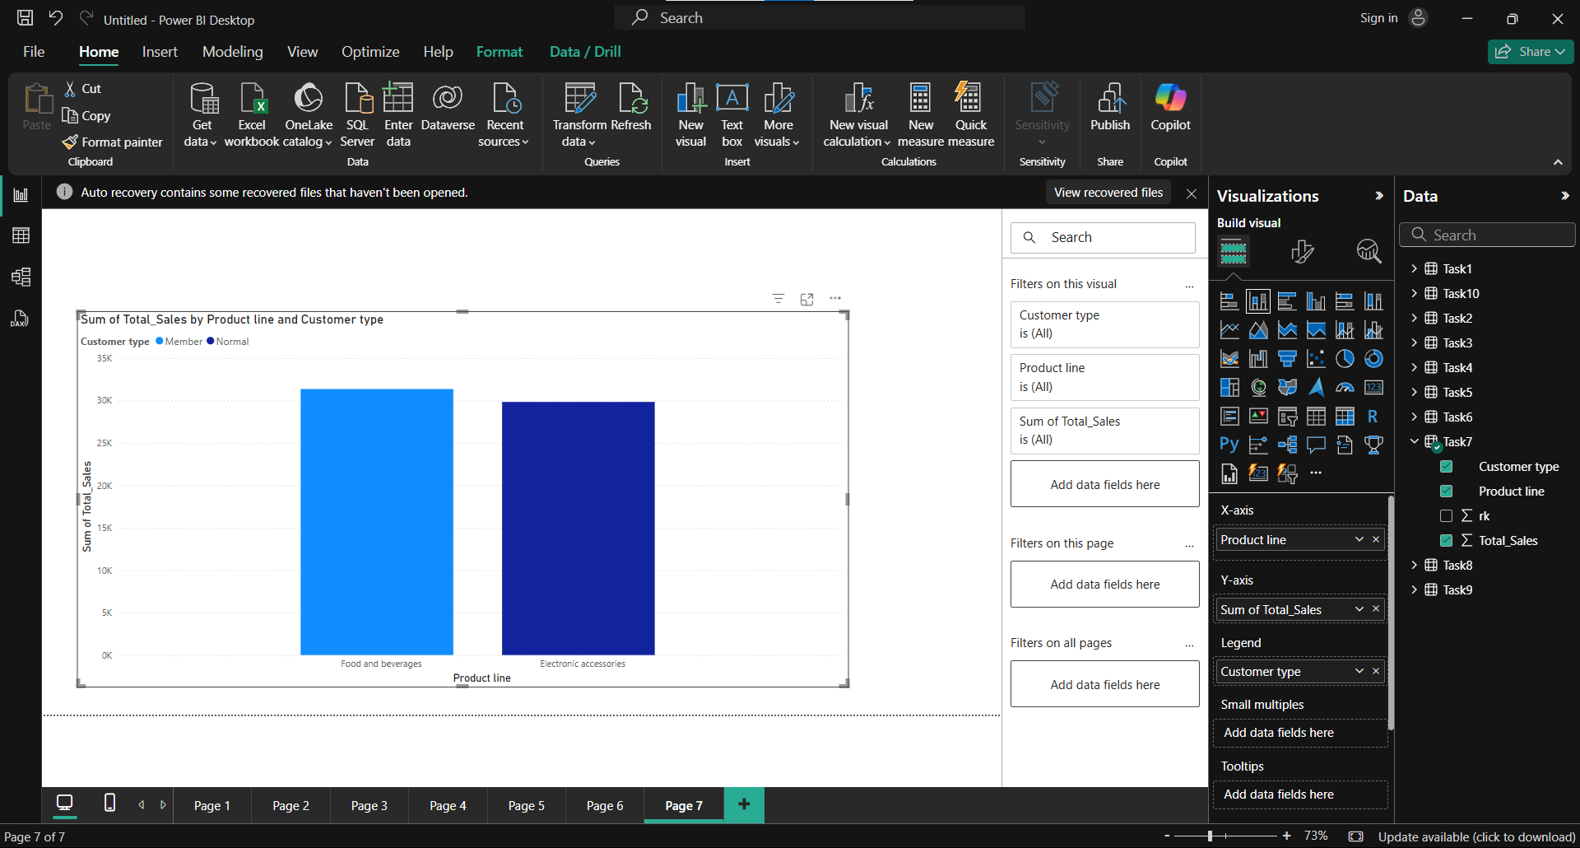

Slide 24
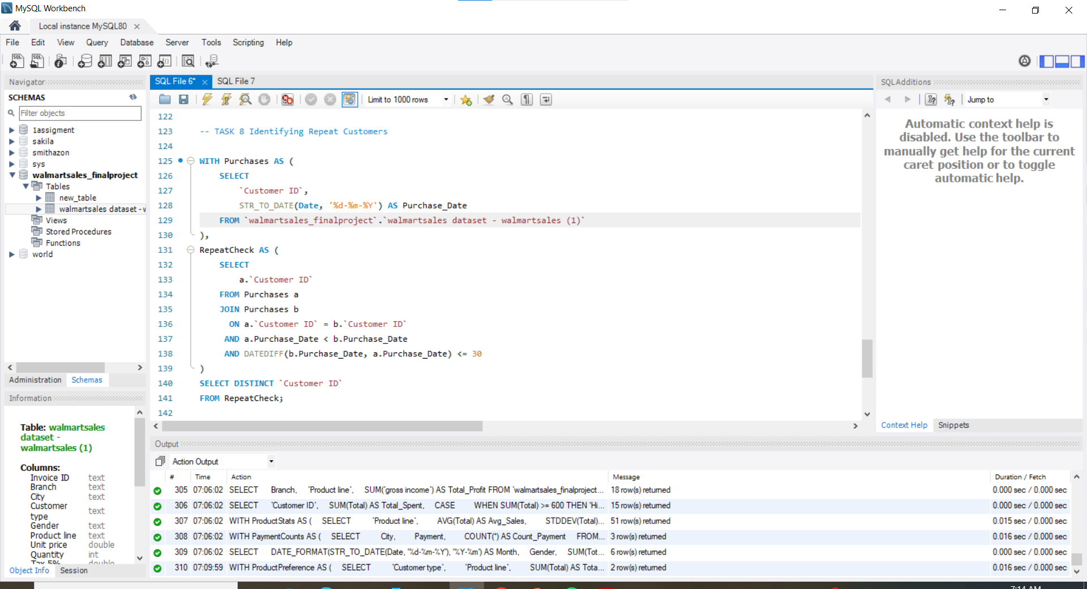

Slide 25
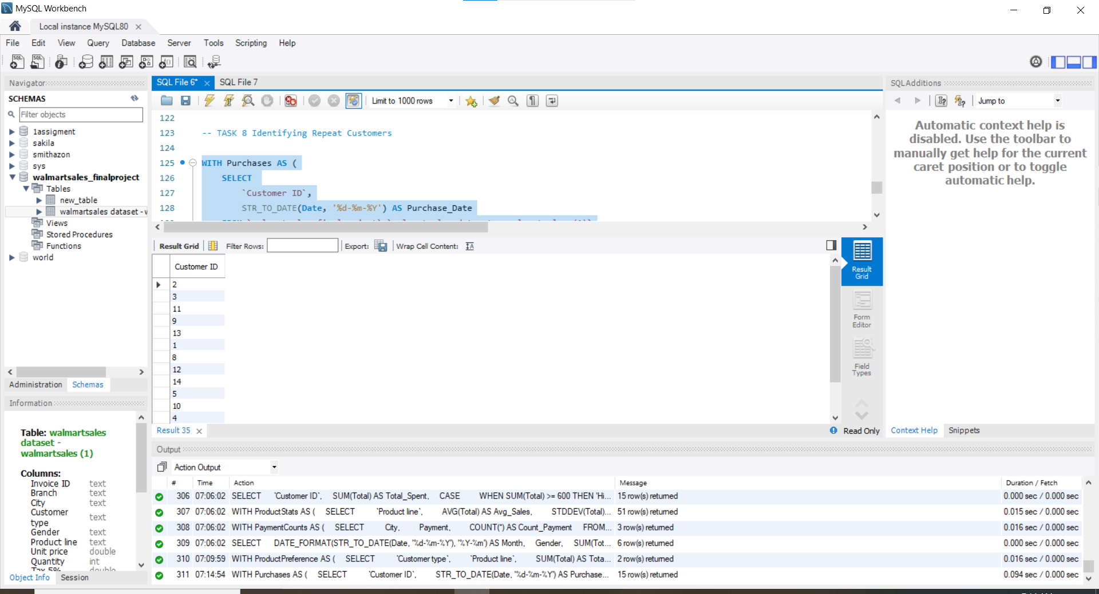

Slide 26
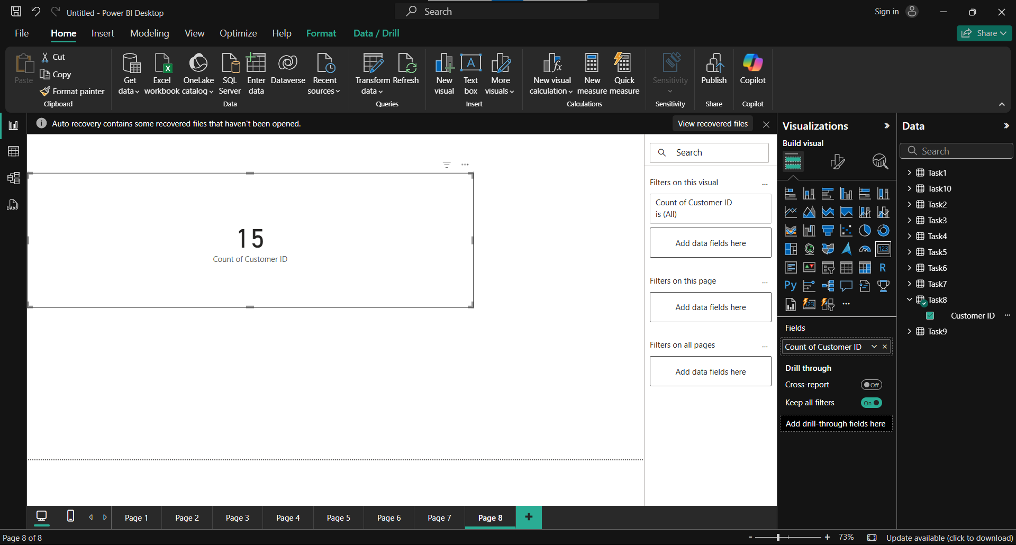

Slide 27
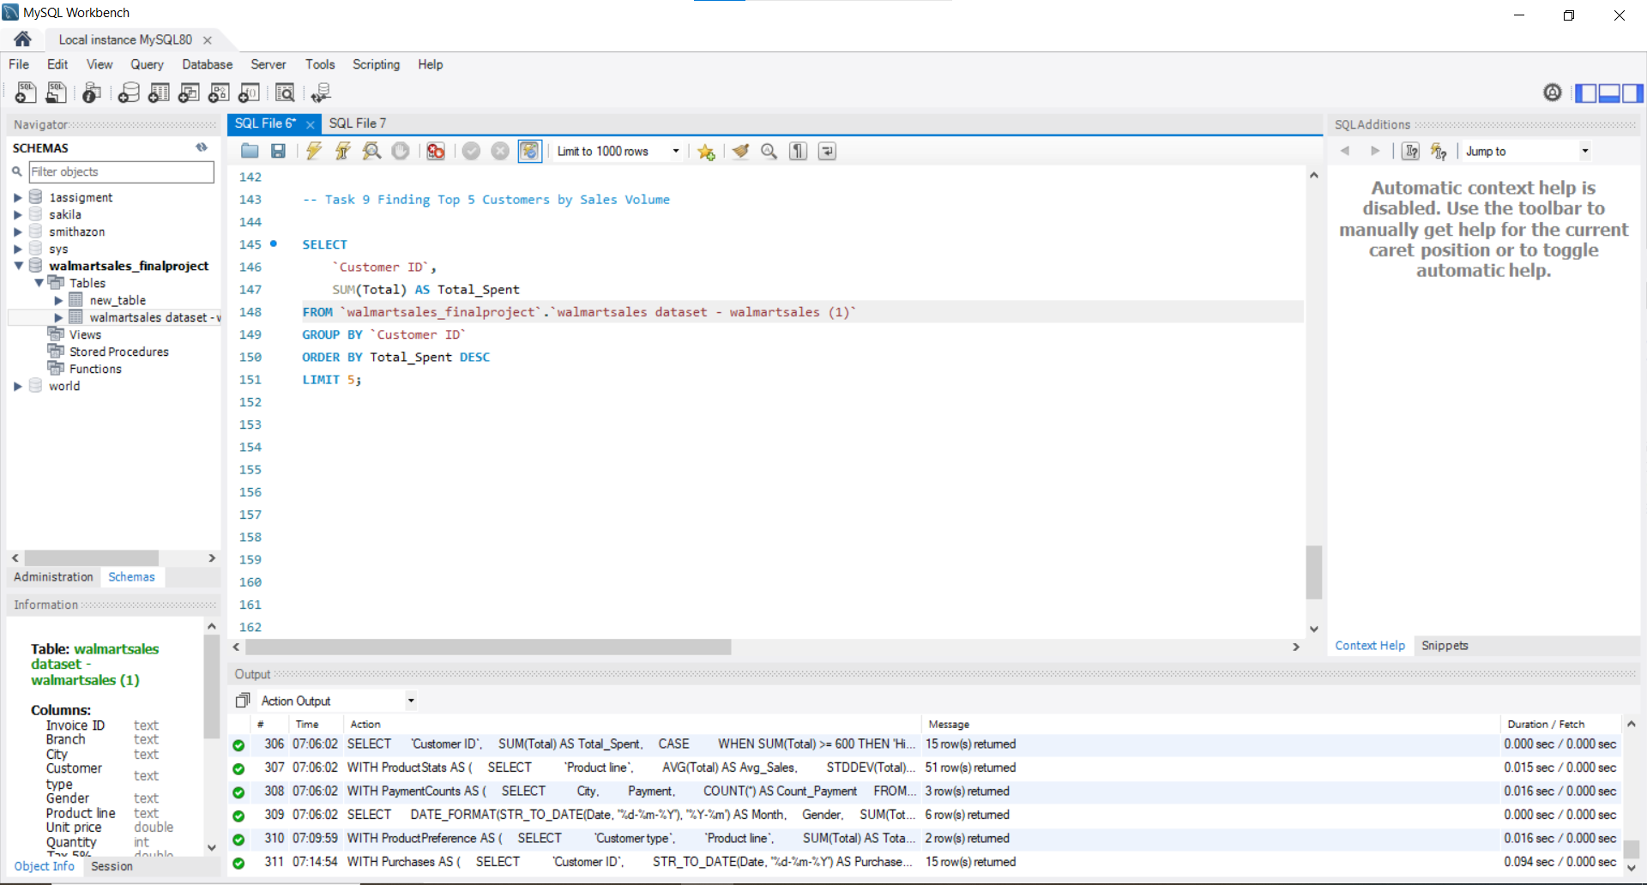

Slide 28
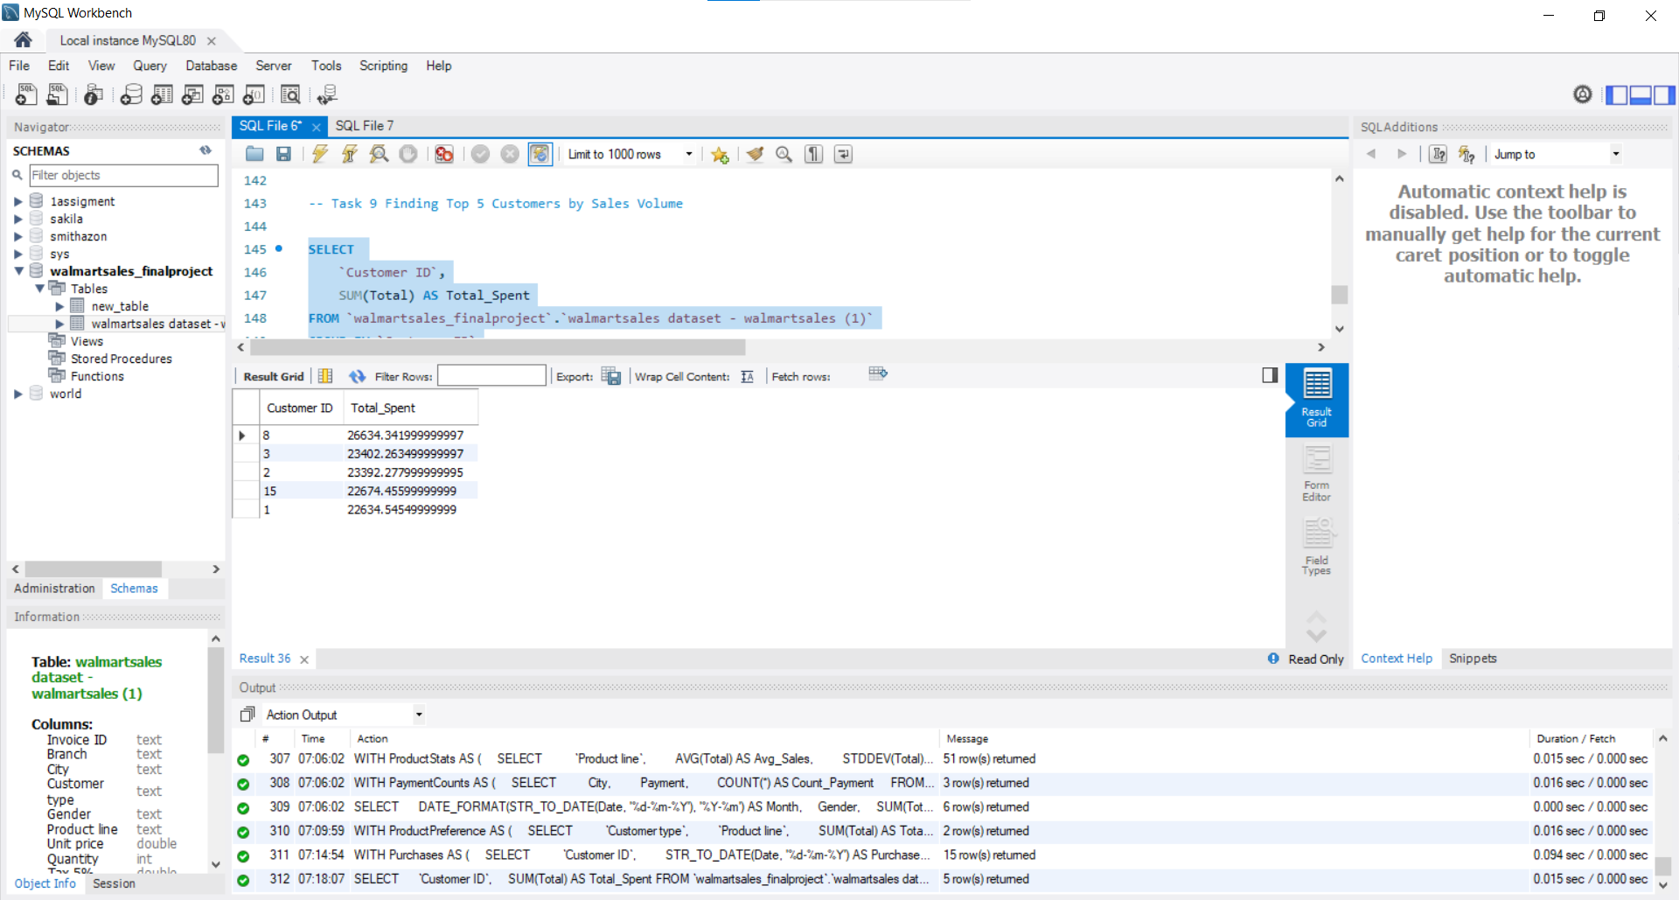

Slide 29
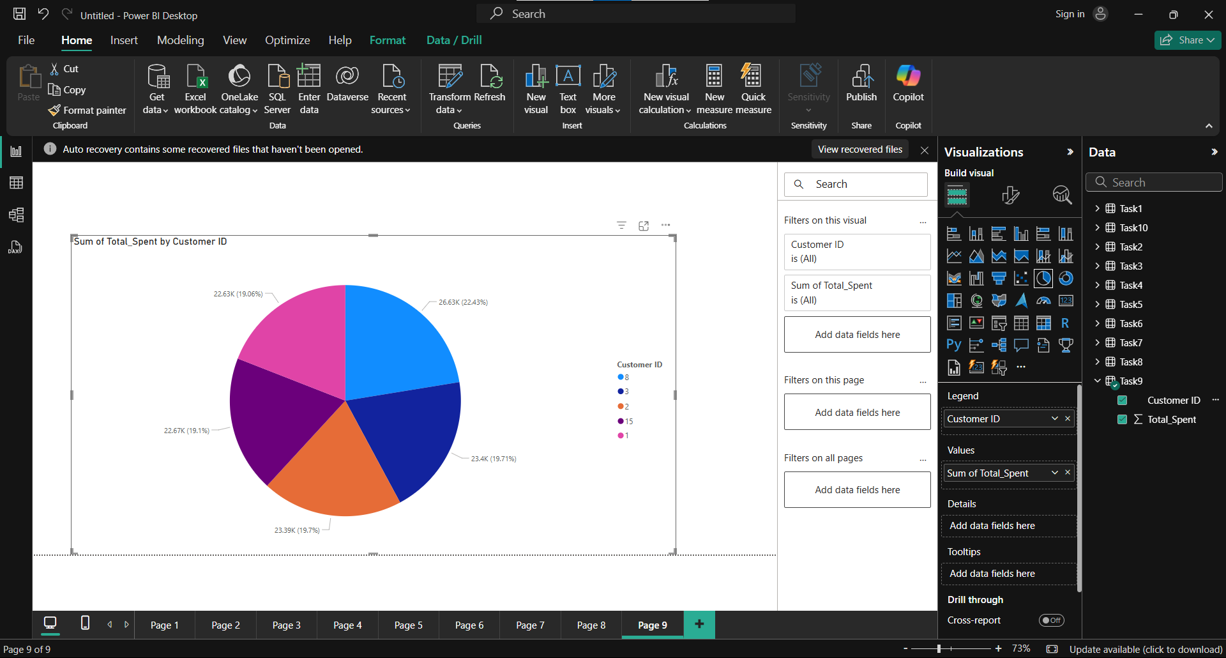

Slide 30
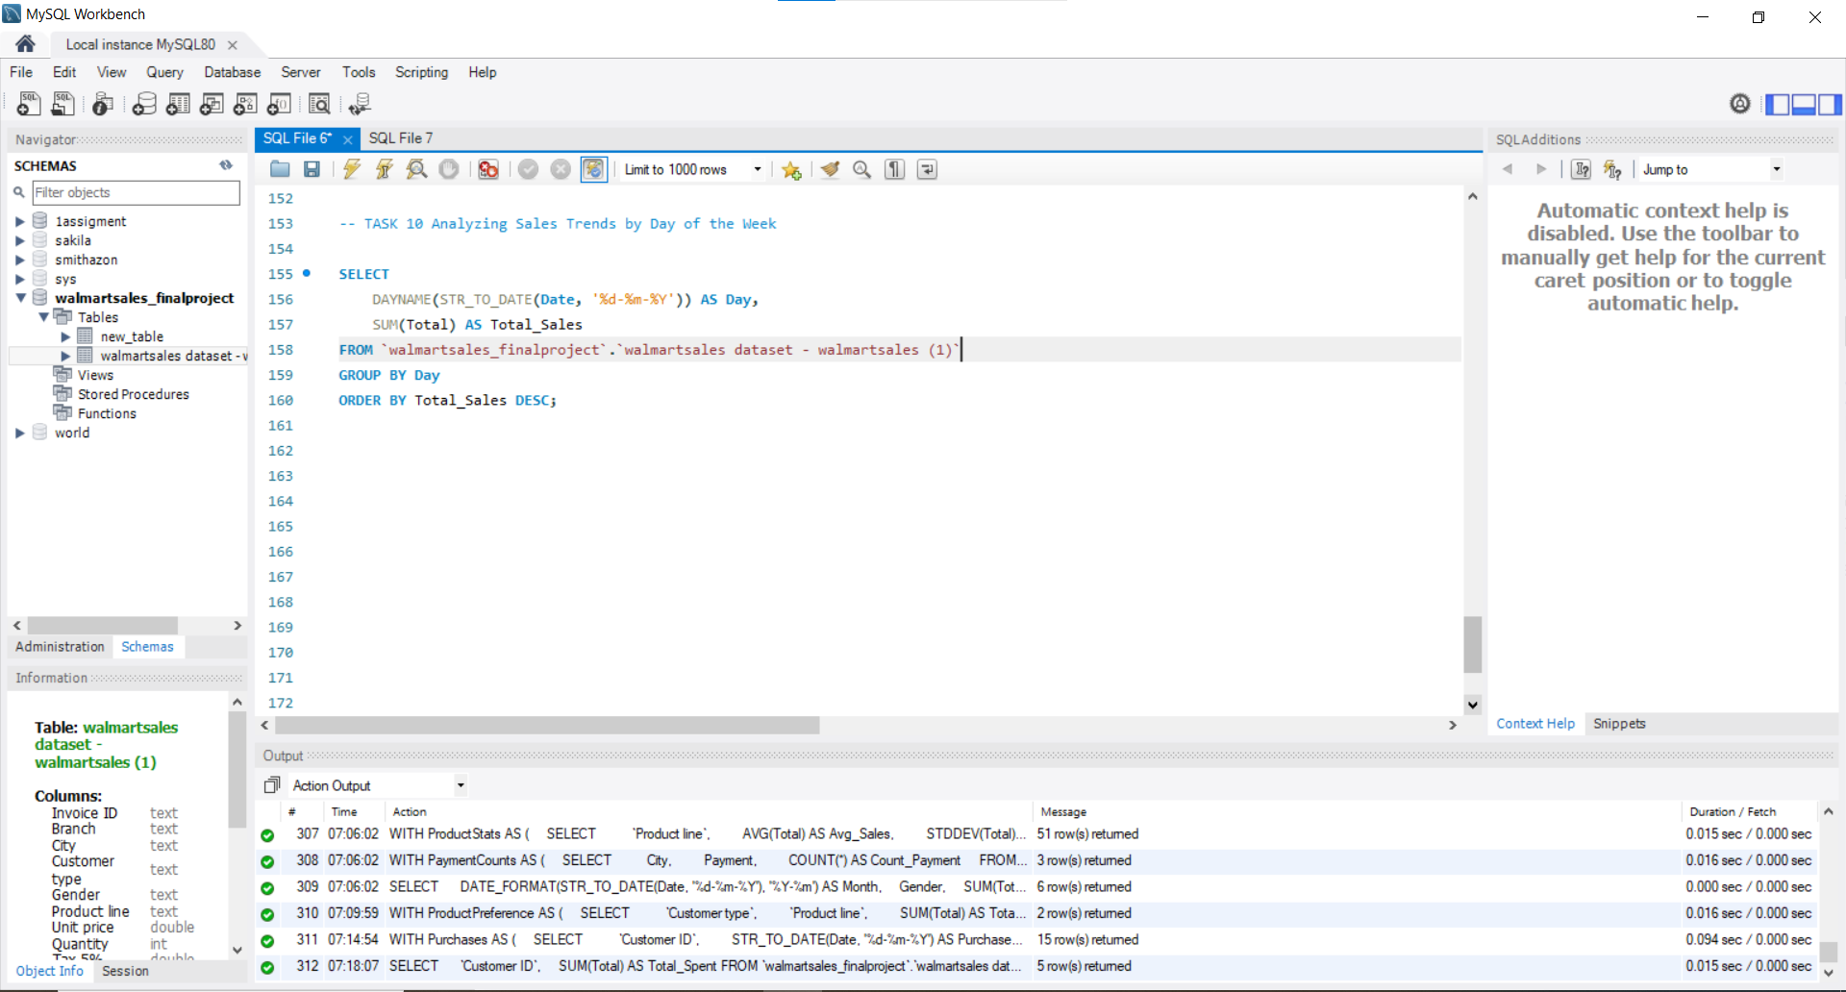

Slide 31
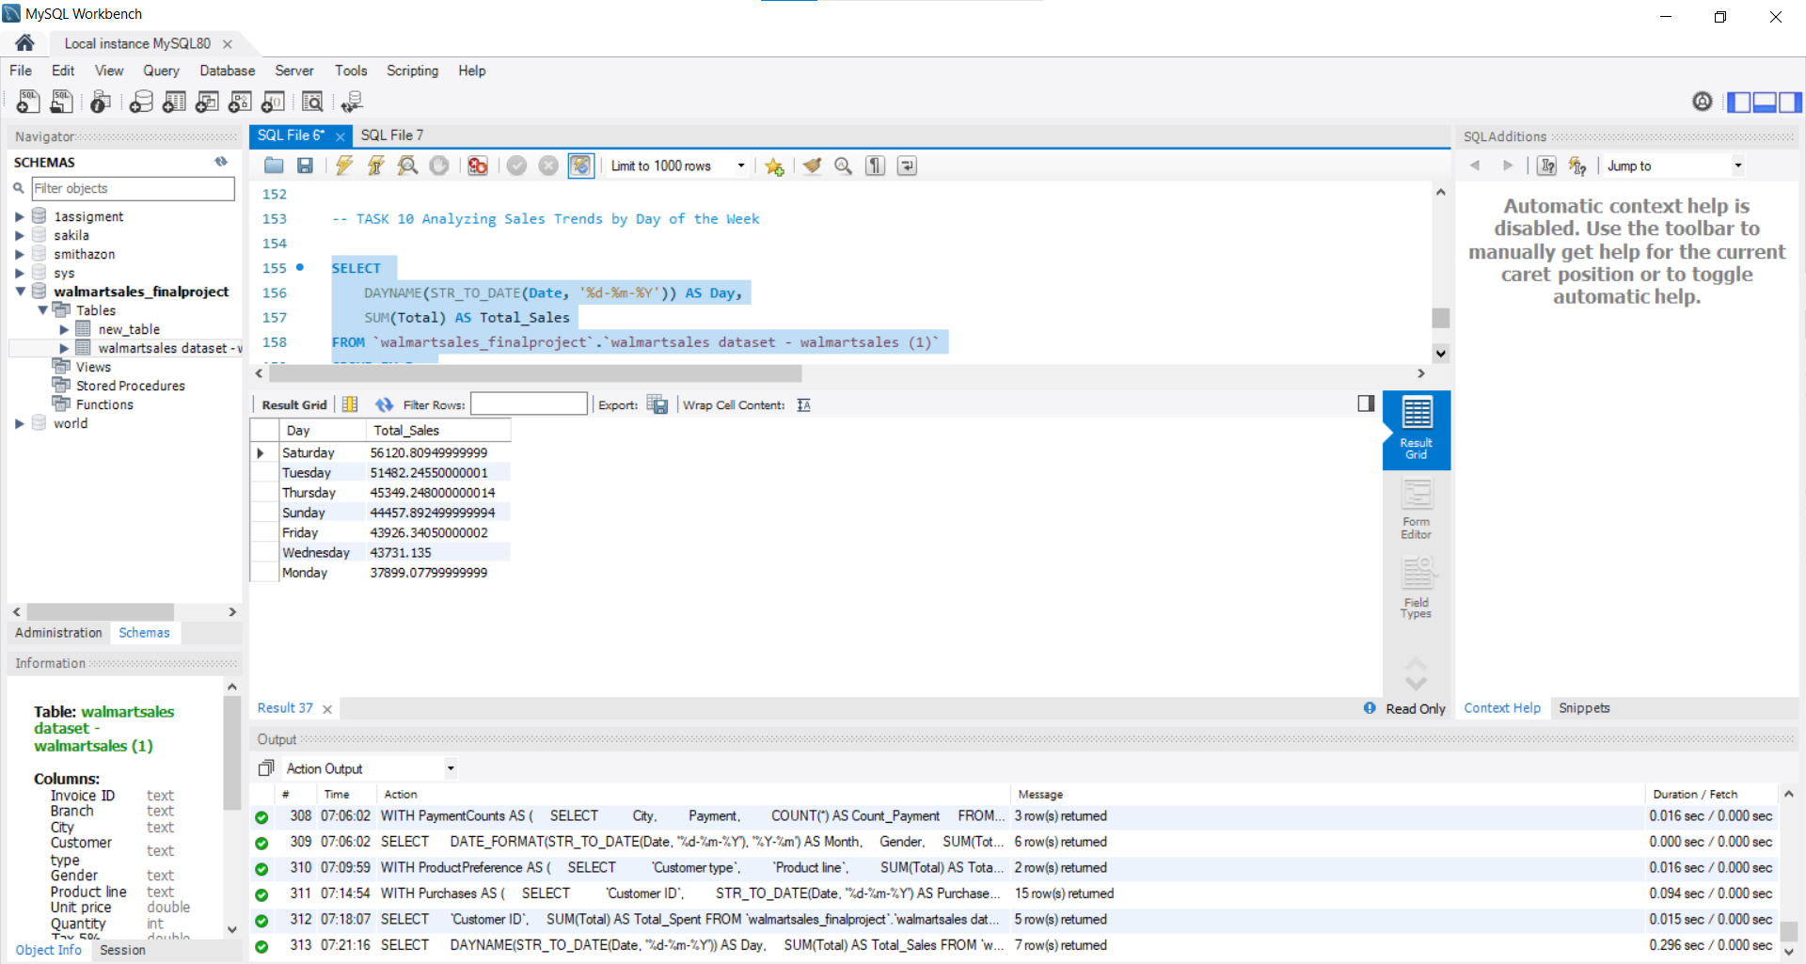

Slide 32
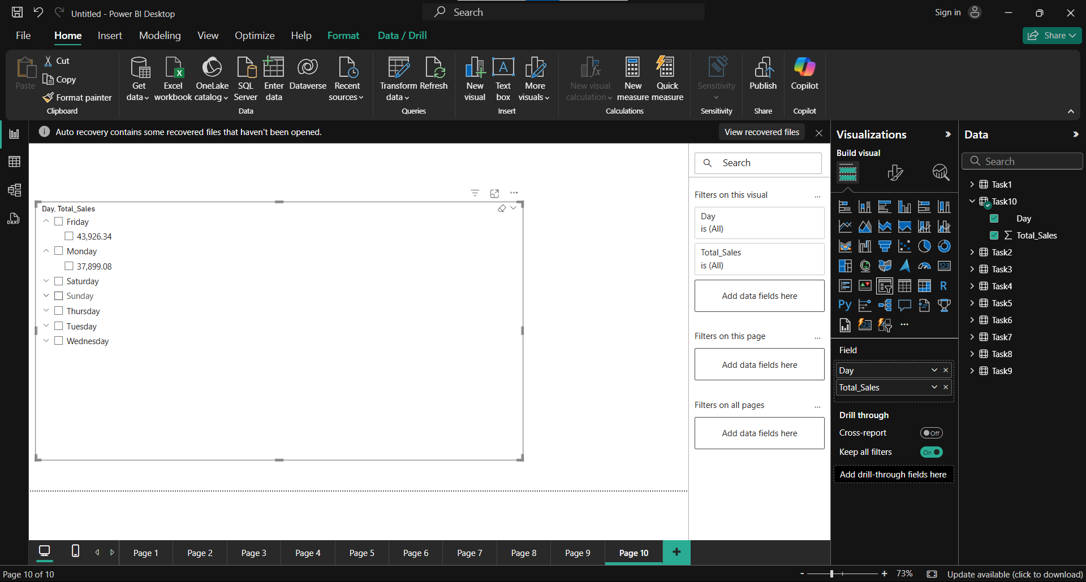

Slide 33
SQL PROJECT VIDEO LINK

